Slide 1

Zero-Day Risk Analyzer– A Frontend-Only Vulnerability Risk Detector
A Web Tool to Simulate the Analysis of Vulnerability Descriptions Using Client-Side Logic
Notes:
1

Slide 2
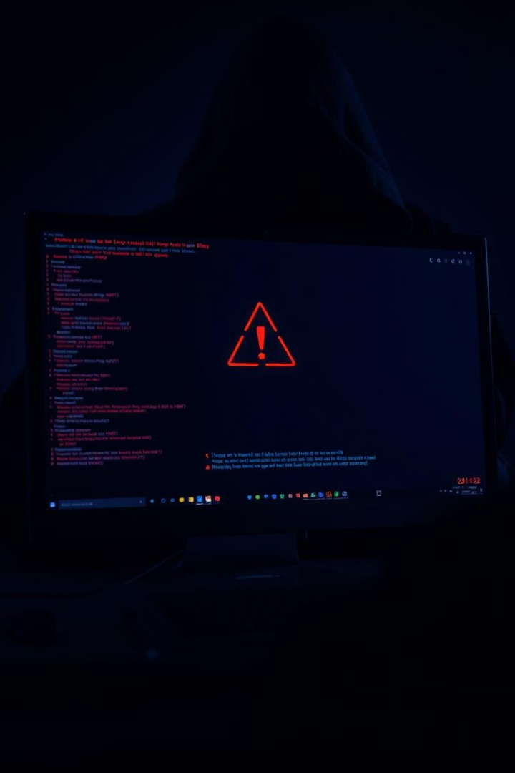

The Need for Simple & Accessible Risk Analysis Tools
Zero-day vulnerabilities pose a major cybersecurity threat.
Most analysis tools are complex or require backend systems.
Beginners and learners need lightweight tools to understand risk analysis concepts.
There’s a gap for simple, browser-based zero-day simulation tools.
Notes:
2

Slide 3

Our Approach: Lightweight, Browser-Based Risk Analysis
Zero-Day Risk Analyzer is a frontend-only web application.
Users input vulnerability descriptions.
The tool simulates risk level prediction using client-side keyword analysis.
No backend or server setup required – simple and fast.
Notes:
3

Slide 4

Architecture & Design
Frontend-Only Architecture (HTML + CSS + JavaScript)
Static webpage with built-in logic
Real-time UI updates using DOM manipulation
Modular structure for future backend integration
Notes:
4

Slide 5
Technology Used :
HTML5 – structure and layout
Provides the fundamental structure of the web page.
CSS3 – modern, dark-themed styling
Adds animations and transitions for improved user experience.
JavaScript (Vanilla) – logic for analyzing descriptions
Handles all the logic behind the vulnerability risk analysis
VS Code / Any IDE – development
Code written and tested using modern IDEs like Visual Studio Code.
Chrome / Firefox – testing environment
Tested on multiple browsers (Google Chrome, Mozilla Firefox, Microsoft Edge) to ensure consistent behavior and appearance.
Notes:
5

Slide 6
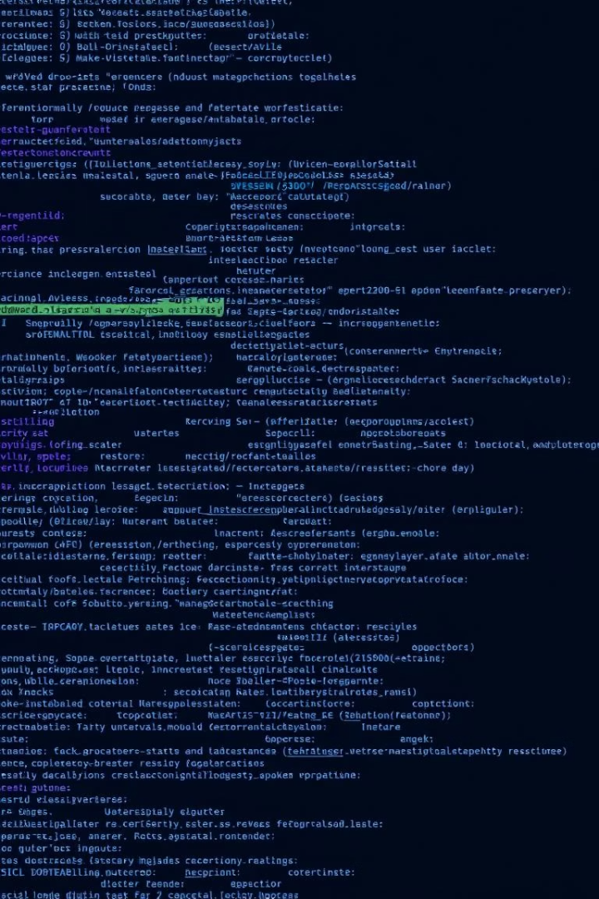
Features :
Clean, intuitive UI
Real-time risk prediction
No internet or server required
Mobile responsive
Easy to extend with a backend model
Notes:
6

Slide 7
Competitive Landscape
Tool Name
Frontend Only
Open Source
Beginner Freindly
ZAP(OWASP)
❌
✅
⚠️ Moderate
Nessuss
❌
❌
⚠️ Professional
Zero-Day Risk Analyzer
✅
✅
Notes:
7

Slide 8
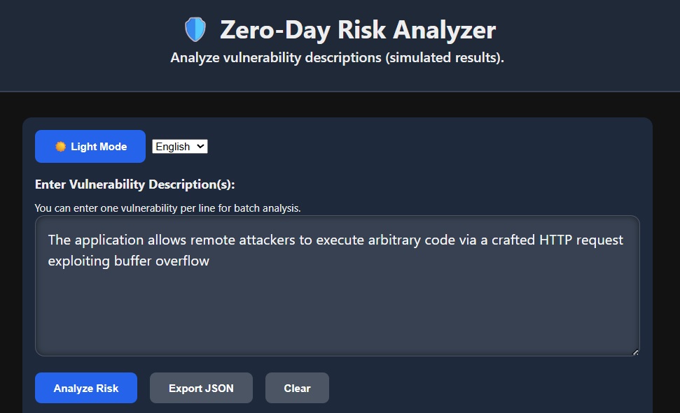
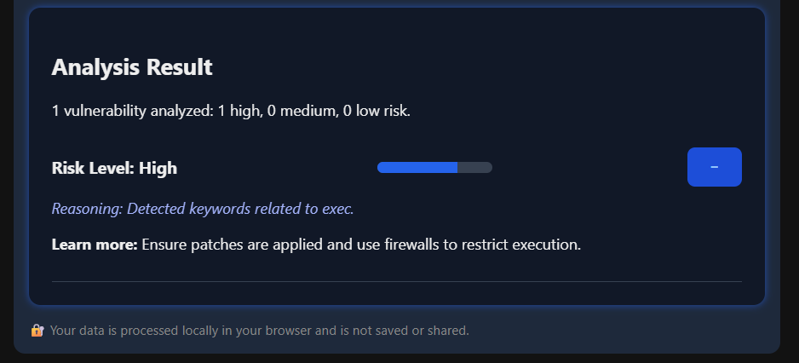
Demo Screenshots / Output
Notes:
8

Slide 9
Industry Relevance : Why This Project Matters to the Cybersecurity Industry
Rising Threat of Zero-Day Vulnerabilities :
Zero-day attacks are among the most dangerous because there are no patches or defenses available initially.
Organizations like Google Project Zero, CISA, and MITRE track thousands of such vulnerabilities annually.
Security is a Top Priority in Every Sector:
Industries like Finance, Healthcare, Government, and Tech are constantly under attack.
Early identification and risk analysis tools help teams prioritize threats and respond faster.
3. Shortage of Skilled Cybersecurity Professionals:
Many organizations lack the in-house expertise for deep analysis.
Lightweight tools like the Zero-Day Risk Analyzer can assist in training, awareness, and early-stage triage.
4. Aligns with OWASP and NIST Goals:
Promotes secure development practices by raising awareness of vulnerabilities.
Encourages risk-based thinking, as recommended by NIST Cybersecurity Framework.
Applicable in Education and Entry-Level Security Roles:
Helps students, interns, and junior analysts simulate vulnerability assessment.
Can be used in training programs, workshops, and simulations.
Notes:
9

Slide 10
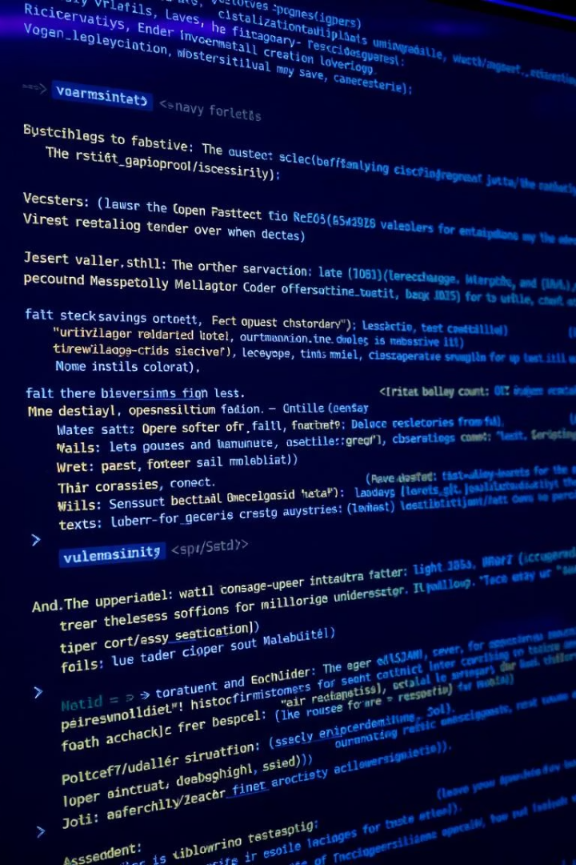
Market Trends & Acceptance
Explosive Growth in the Cybersecurity Market
The global cybersecurity industry is projected to exceed $300 billion by 2027.
Demand for faster, smarter threat detection is increasing rapidly across sectors.
2. Surge in Zero-Day Exploits
2023 saw 28,000+ new vulnerabilities (CVEs), with a significant rise in zero-day threats.
Major breaches (e.g., Log4Shell, MOVEit) highlight the need for early risk analysis tools.
3. Rise of AI & Machine Learning in Security
Companies are integrating AI/ML models to predict and analyze cyber threats.
GNNs (Graph Neural Networks) are gaining popularity for analyzing software structure and vulnerability relationships — just like your tool is designed to extend into.
4. Demand for Lightweight, Frontend-Based Tools
Organizations value tools that work without complex setups or backend services.
Your tool runs entirely in-browser, making it portable, efficient, and easy to integrate into workflows or learning platforms.
5. Growing Cybersecurity Education Sector
Rising focus on cybersecurity skilling for students, interns, and non-technical staff.
Your project supports learning and awareness, acting as a bridge to more advanced backend or AI-driven security tools.

Slide 11
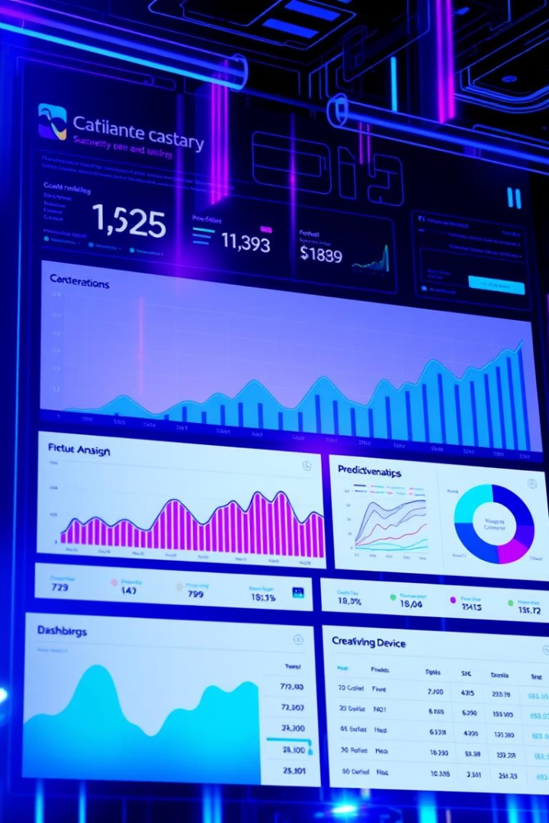
Future Improvements
1
Integrate a real Graph Neural Network backend
2
Add API support (FastAPI + Python backend)
3
Allow upload of CVE files or vulnerability databases
4
Show confidence scores from trained ML models
Notes:
11

Slide 12
Use Case — Industry & Company Fit
The Zero-Day Risk Analyzer is ideal for environments where quick, accessible vulnerability analysis is needed without deep backend integration . It offers educational value, triage support, and a foundation for future automation in real-world cybersecurity workflows.
Educational Institutions
Startups & Small Security Teams
Security Research & Intern Projects
Developer Integration (Future Scope)
Industry Fit

Slide 13
Conclusion & Learning
The Zero-Day Risk Analyzer demonstrates that even simple, browser-based tools can play a crucial role in vulnerability awareness and early risk assessment.
While lightweight and frontend-only, it simulates real-world logic that can be scaled using advanced techniques like Graph Neural Networks and backend integration.
✔️ Designed a functional, interactive cybersecurity tool using only HTML, CSS, and JavaScript
✔️ Simulated real-world vulnerability triage using keyword-based logic
✔️ Built a modular and extendable architecture for future AI/ML-based analysis
✔️ Addressed a practical industry need for quick and accessible vulnerability risk analysis
✔️ Aligned with modern trends in AI, frontend development, and cybersecurity education
Designed a functional, interactive cybersecurity tool using only HTML, CSS, and JavaScript
Simulated real-world vulnerability triage using keyword-based logic
Built a modular and extendable architecture for future AI/ML-based analysis
Addressed a practical industry need for quick and accessible vulnerability risk analysis
Aligned with modern trends in AI, frontend development, and cybersecurity education

